Slide 1

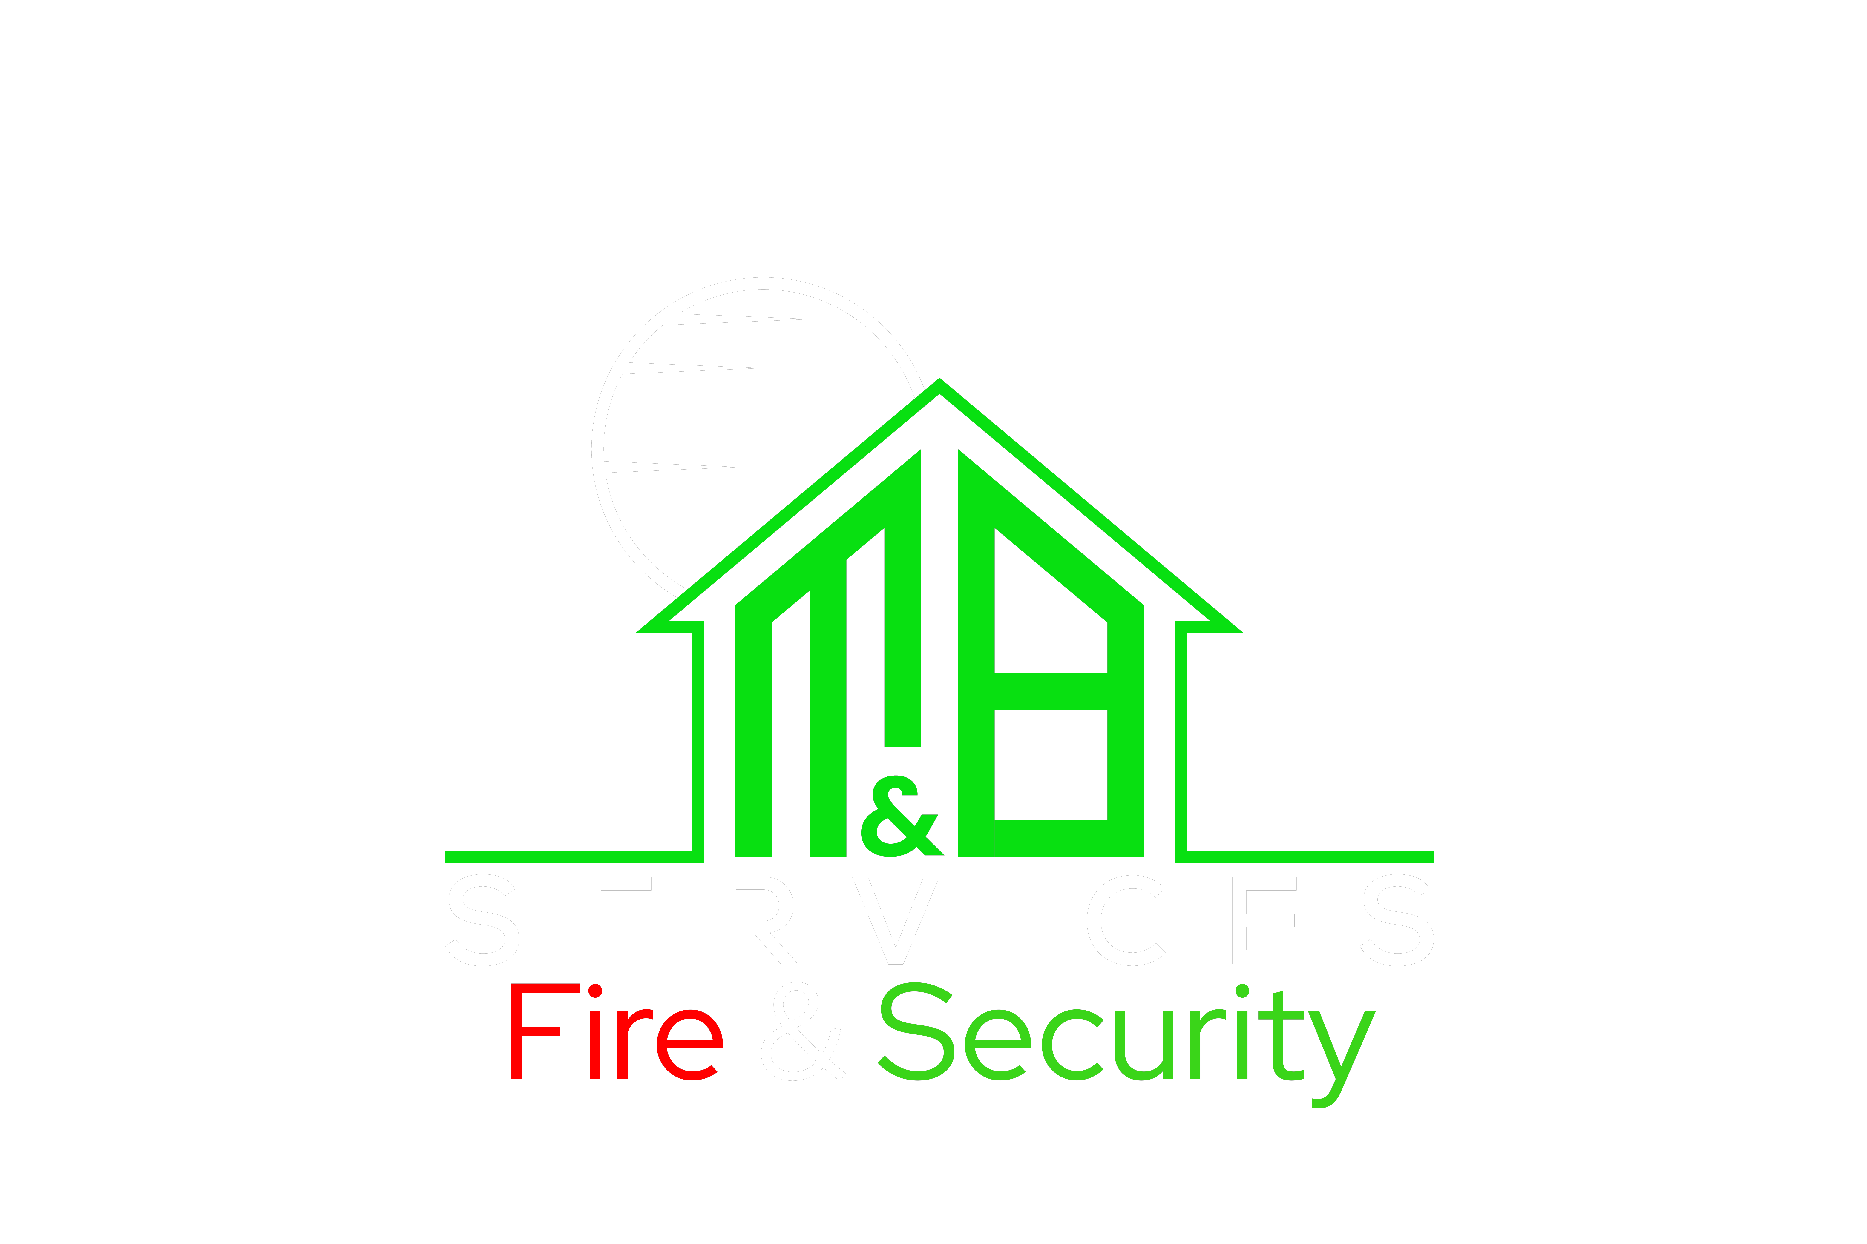
Commercial
Security Tips
Tel: 07845 189 752
Email: Info@MandB-Services.co.uk
Web: WWW.MandB-Services.co.uk

Slide 2
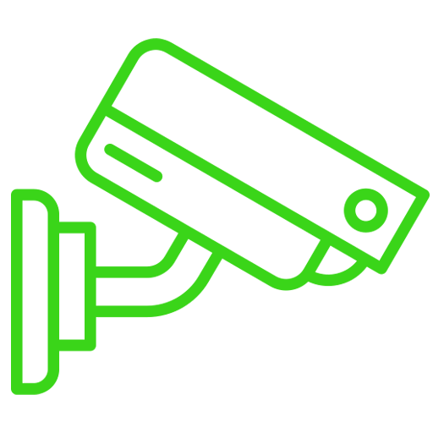
Having operational CCTV is essential for any business because it not only protects your property and helps to deter theft and vandalism and other security threats.
But also creates a safer environment for employees and customers by discouraging inappropriate or dangerous behaviour. And In the event of an incident, clear video footage can offer valuable evidence for investigations, insurance claims, and legal protection.
Beyond security, CCTV can also support operational efficiency by helping monitor workflow, customer traffic, and compliance with company procedures. Overall, maintaining effective, working CCTV helps safeguard your business, reduce risk, and promote a more secure and productive workplace.
Tel: 07845 189 752
Email: Info@MandB-Services.co.uk
Web: WWW.MandB-Services.co.uk

Slide 3

Business owners should ensure they have an adequate alarm system that is fully operational because it provides immediate notification if a break-in or security breach occurs. An alarm doesn't just make noise, its also a good visual deterrent.
This significantly reduces the chance of property loss or damage.
Seeking advice and using approved suppliers for alarms and CCTV is equally important, as reputable providers ensure the equipment meets industry standards, is installed correctly, and is reliable when you need it most.
By taking these steps seriously, business owners can protect their premises, staff, and assets while also demonstrating due diligence to insurers and potentially lowering insurance costs
Tel: 07845 189 752
Email: Info@MandB-Services.co.uk
Web: WWW.MandB-Services.co.uk

Slide 4

It's extremely important to have a compliant and fully operational fire alarm system in Commercial properties, this is not only because it is required by law in the UK, but it is also an active measure to keep you, your employees and customers safe.
It's important to have your fire alarm systems professionally serviced at least every six months. In addition, a responsible person (e.g., a staff member) must conduct a weekly test of a manual call point.
As with most of these tips, taking these steps seriously, business owners can protect their premises, staff, and assets while also demonstrating due diligence to insurers and potentially lowering insurance costs and like an intruder alarm, This significantly reduces the chance of property loss or damage.
Please note: The specific rule vary depending on the type of business you’re running, and you should seek professional advice if you are ever unsure!
Tel: 07845 189 752
Email: Info@MandB-Services.co.uk
Web: WWW.MandB-Services.co.uk

Slide 5

Locking doors may seem obvious, but it's a critical security measure that every business owner must prioritize.
Ensuring all Locks are in good working condition and doors are properly locked and secured, both during and after business hours-helps prevent unauthorized access, reduces the risk of theft or vandalism, and protects valuable assets inside the premises.
It also helps safeguard employees by maintaining a controlled environment where only permitted individuals can enter. In addition to preventing crime, consistently locking doors shows insurers that proper security procedures are being followed, which can support insurance claims if an incident occurs.
These basic habits form the foundation of a strong security strategy, helping business owners protect their people, property, and peace of mind.
Tel: 07845 189 752
Email: Info@MandB-Services.co.uk
Web: WWW.MandB-Services.co.uk

Slide 6

Having shutters installed is an important security measure for any business because they provide a strong physical barrier that helps protect your premises from break-ins, vandalism, and damage.
Shutters not only make it significantly harder for intruders to gain access, but it also deters criminals before they even attempt to enter.
Shutter also have the added benefit of shielding windows and doors from accidental damage or severe weather reducing repair costs and business interruptions.
Beyond physical protection, shutters offer peace of mind-both during closed hours and when the building is unoccupied for long periods of time.
By investing in quality shutters, business owners demonstrate a proactive approach to safeguarding their property, assets, and operations.
Tel: 07845 189 752
Email: Info@MandB-Services.co.uk
Web: WWW.MandB-Services.co.uk

Slide 7

Using the correct lighting is a simple but highly effective way for businesses to prevent break-ins.
Well-lit entrances, walkways, and exterior areas reduce hiding spots and make it much harder for intruders to approach unnoticed. Criminals are far less likely to target a business that is visibly illuminated, as good lighting increases the chances of being seen by passers-by, neighbours, or CCTV cameras.
Interior lights on timers can also create the appearance that someone is present, further discouraging unauthorized access. In addition to boosting security good lighting improves safety for employees and customers during darker hours.
Overall, strategic lighting is a cost-effective, proactive measure that strengthens your business's security and reduces the risk of criminal activity
Tel: 07845 189 752
Email: Info@MandB-Services.co.uk
Web: WWW.MandB-Services.co.uk

Slide 8

An intercom system is an important security and communication tool for any business because it allows you to control and verify who enters your premises.
By letting staff speak with visitors or delivery personnel without opening the door, an intercom reduces the risk of unauthorized entry and helps maintain a safe environment for all.
For businesses with reception areas, restricted zones, or multiple departments, an intercom enhances efficiency while adding an extra layer of protection. Overall, it supports both security and the daily operations of your business.
Tel: 07845 189 752
Email: Info@MandB-Services.co.uk
Web: WWW.MandB-Services.co.uk

